Slide 1

B L I S S F U L W E D D I N G P A C K A G E S

Slide 2
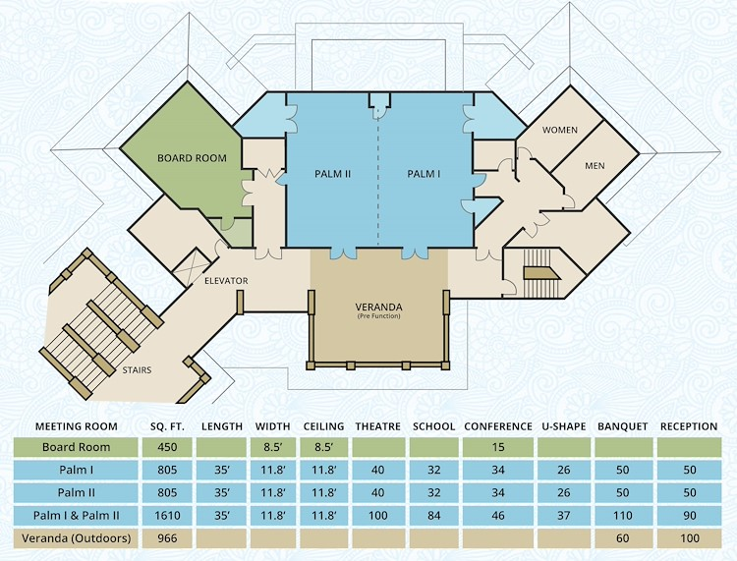
Whether you're looking to plan an intimate gathering or a grand affair, Floridays Resort Orlando will create a memorable experience for you and your guests. You’ll work directly with our Sales & Catering Manager to design the perfect wedding from catering and banquet services to blocking guest rooms.
Because your wedding day involves so many details and you deserve a stress-free day, we strongly recommend you hire a professional wedding planner who we can work closely with to assist with vendor selections, vendor contracts, rehearsal coordination, ceremony & reception timeline and placement of wedding day items.
Floridays Resort offers a private oasis on the second floor of the main building that offers breathtaking views from the veranda overlooking the pool as well as our Palms Ballroom. We are well suited for weddings for up to 70 guests. The Palms I & II has 2000 square feet of flexible event space while our 1000 square foot covered veranda is ideal for your ceremony and cocktail hour. Our Boardroom is also a perfect location for your Bridal Party to gather before the ceremony and reception.

Slide 3
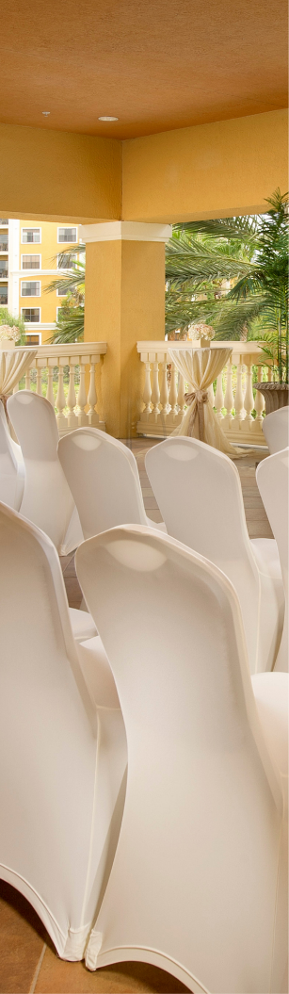
B L I S S F U L W E D D I N G P A C K A G E S
W E D D I N G S
A L L P A C K A G E S I N C L U D E
Outdoor Ceremony on Covered Veranda
Private Ballroom for Four-Hour Reception
In-House White Floor Length Table Linen and Napkins
White Spandex Chair Covers
Additional Tables on Request (Gift, Guest Book, Cake and Place Card)
Votive Candles available for Cocktail Tables
Complimentary Cake Cutting Service
Champagne Toast for all Guests (Sparkling Cider also available)
Private Menu Tasting for Two Guests
Special Amenity for Couple on Wedding Night
Discounted Room Rates for Overnight Guests
Special $149.00 Room Rate for Wedding Couple up to Three Nights

Slide 4

B L I S S F U L W E D D I N G P A C K A G E S
COCKTAIL RECEPTION
Choice of three (3) Butler Passed Hors d’Oeuvres.
H O T H O R S D ‘ O E U V R E S
Mini Quiche $ 225.00
Jalapeno Poppers with Ranch $ 200.00
Crispy Spring Rolls with Sweet Chili Sauce $ 200.00
Meatball Skewers $ 200.00
Mini Beef Sliders $ 250.00
Chicken Satay Skewers with Mango Sauce $250.00
Three Cheese Quesadillas $ 200.00
Buffalo Chicken Wings $ 300.00
Coconut Shrimp with Pineapple Relish $ 350.00
C O L D H O R S D ‘ O E U V R E S
Shrimp Cocktail Shots $ 350.00
Ham and Cheese Pinwheels $250.00
Cucumber Rounds with Crab Salad $ 350.00
Strawberry Brownie Kabobs $ 225.00
Vegetable Crudité Shots with Ranch $ 250.00
Caprese Skewers with Balsamic Drizzle $ 250.00
All prices listed are subject to 22% Taxable Service Charge and 6.5% Sales Tax.

Slide 5
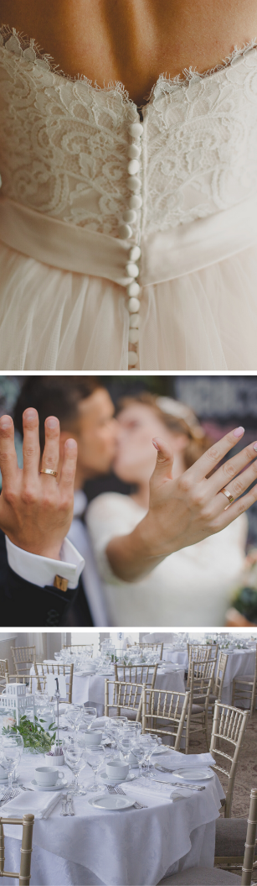
B L I S S F U L W E D D I N G P A C K A G E S
BLISSFUL
WEDDING BUFFET
V E G E T A B L E S
Choice of Two
Marinated Grilled Vegetable Salad
Red Skin Potato Salad
Antipasto Pasta Salad with Balsamic Vinaigrette
Garden Greens with Tomatoes, Cucumbers, Carrots and Ranch Dressing
Fresh Fruit Salad topped with Toasted Coconut Flakes
Grilled Vegetable Salad
P R O T E I N S
Choice of Two
Grilled Beef Tips with Mushroom Cabernet Sauce
Grilled Salmon* with Lemon Garlic Butter Sauce
Grilled Chicken Breast with Mango Sauce
Roast Pork Loin with Marsala Wine Sause
Citrus Herb Grilled Mahi-Mahi with Tomato Cream Sauce
S T A R C H E S
Choice of Two
Yellow Jasmine Rice
Garlic Mashed Potatoes
Penne Pasta in Garlic Olive Oil
Baked Rosemary Red Skin Potatoes
Caribbean Vegetable Medley
Roasted Seasonal Vegetables
Green Beans with Blistered Tomatoes and Caramelized Baby Onions
Steamed Broccoli
$75.00 per person*
(Minimum of 25 people to order)
All prices listed are subject to 22% Taxable Service Charge and 6.5% Sales Tax.

Slide 6
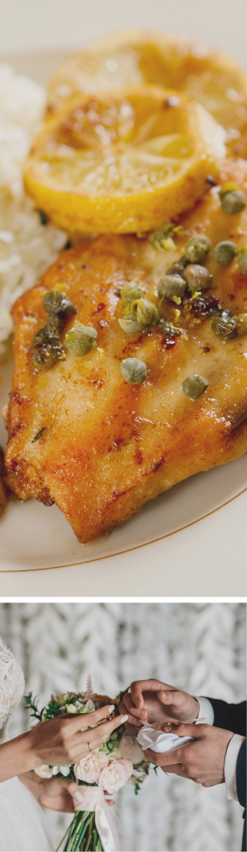
B L I S S F U L W E D D I N G P A C K A G E S
AMORE
WEDDING BUFFET
C O L D D I S P L A Y
Choice of Two
Sauteed Zucchini and Tomato Salad
Rotini Pasta with Kalamata Olives and Feta Cheese
Antipasto Pasta Salad with Balsamic Vinaigrette
Caesar Salad with Freshly Grated Parmesan Cheese
Grilled Vegetable Salad
H O T E N T R E E S
Choice of Three
Chicken Piccata with Lemon Caper Sauce
Pan Seared Chicken Gorgonzola
Chicken Parmesan
Grilled Italian Sausage with Peppers and Onions
Baked Salmon **with a Sun-Dried Tomato Pesto
Marsala Beef Tips
Choice of Two
Green Beans with Toasted Almonds
Sauteed Fresh Vegetables
Rotini Pasta with Olive Oil and Fresh Herbs
Tri-Color Tortellini Alfredo
Garlic Mashed Potatoes
Yellow Rice
$75.00 per person*
(Minimum of 25 people to order)
** Please add $ 10.00 per person
All prices listed are subject to 22% Taxable Service Charge and 6.5% Sales Tax.

Slide 7
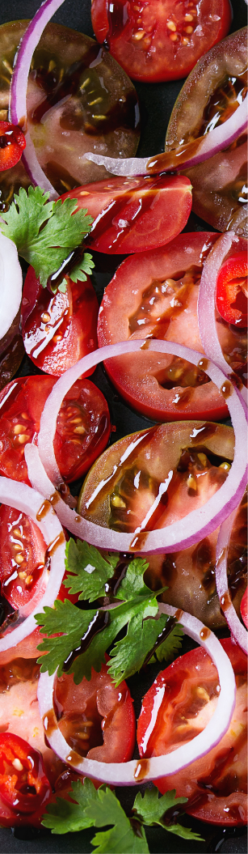
B L I S S F U L W E D D I N G P A C K A G E S
TROPICAL
WEDDING BUFFET
C O L D D I S P L A Y
Choice of Two
Cilantro Marinated Grilled Vegetables
Tomato and Bermuda Onion Salad with Citrus Vinaigrette
Roasted Corn and Black Bean Salsa
Red Skin Potato Salad with Garlic and Bacon
Garden Salad with Tomatoes, Cucumbers, Onions, Mushrooms and choice of dressing
H O T E N T R E E S
Choice of Two
Baked Chicken with Mango Sauce
Cuban Shredded Beef Stew
Slow Roasted Pork Loin with Mojito Sofrito
Grilled Mahi-Mahi with Pineapple Salsa
Caribbean Jerk Chicken
Choice of Three
Yuca con Mojo
Cilantro Potatoes
Black Beans
Baked Sweet Plantains
Latino Yellow Rice
Fresh Sauteed Vegetables
$65.00 per person*
(Minimum of 25 people to order)
All prices listed are subject to 22% Taxable Service Charge and 6.5% Sales Tax.

Slide 8
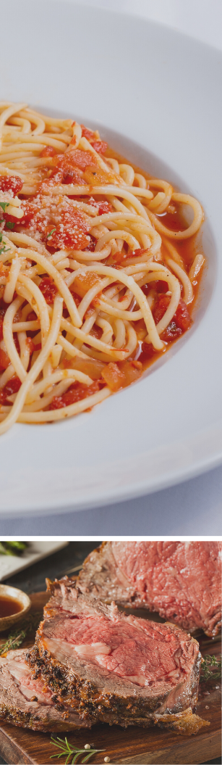
B L I S S F U L W E D D I N G P A C K A G E S
ENHANCEMENTS
M A N N E D C A R V I N G
S T A T I O N
$50 Carving Fee. Warm Rolls and Butter included.
Herb Roasted Beef Strip Loin served with a Wild Mushroom Demi Sauce
Rosemary Roasted Prime Rib with a Horseradish Sauce and Au Jus
Southern Fried Turkey Breast with Rosemary-Cranberry Sauce
Whole Baked Honey Glazed Ham served with a Mango/Pineapple Salsa
………. $ Market Price
.…………….. $ Market Price
...……………. $300 (Serves 40)
.... $300 (Serves 40)
P A S T A S T A T I O N
Choice of two:
Rotini, Tortellini, Penne or Ravioli
Marinara Sauce, Alfredo Sauce or Pesto Sauce
Garlic Bread, Grated Parmesan Cheese, Olives, Mushrooms and Sun-Dried Tomatoes are included
$19.00 per person*
(Minimum of 25 people to order)
M A S H E D P O T A T O
S T A T I O N
Chef’s Choice of Mashed Potatoes
Assorted Toppings to include Bacon Bits, Shredded Cheddar Cheese, Sour Cream, Chives and Butter
$16.00 per person*
(Minimum of 25 people to order)
All prices listed are subject to 22% Taxable Service Charge and 6.5% Sales Tax.

Slide 9
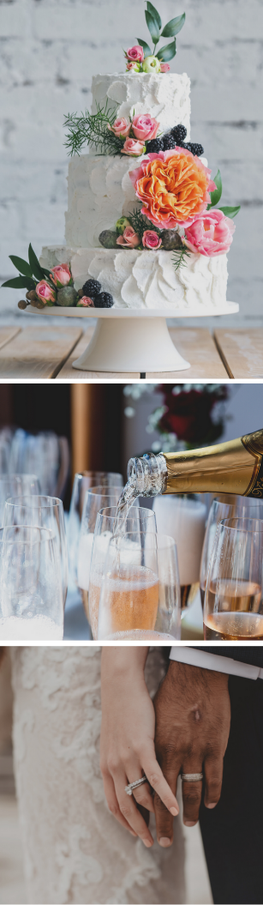
B L I S S F U L W E D D I N G P A C K A G E S
ENHANCEMENTS
R E H E A R S A L D I N N E R
Caesar Salad with Freshly Grated Parmesan Cheese
Spring Green Salad with Heirloom Tomatoes, Cucumbers, Carrots and choice of dressing
Chicken Piccata in Lemon Caper Sauce
Vegetable or Meat Lasagna
Sauteed Fresh Vegetables
Rotini Pasta with Olive Oil and Fresh Herbs
Warm Dinner Rolls and Butter
Assorted Cakes
Freshly Brewed Starbucks Coffee
Iced Tea and Water
$35.00 per person*
(Minimum of 20 people to order)
All prices listed are subject to 22% Taxable Service Charge and 6.5% Sales Tax.

Slide 10

B L I S S F U L W E D D I N G P A C K A G E S
ENHANCEMENTS
D A Y A F T E R B R U N C H
Chilled Florida Orange Juice
Sliced Fresh Fruit Tray
Fluffy Scrambled Eggs
Bacon, Pork or Sausage Patties
Assorted Breakfast Pastries
Home Fried Potatoes
Bagels and Cream Cheese
Butter and Fruit Preserves
Freshly Brewed Starbucks Coffee
Assorted Herbal Teas with Lemon
$25.00 per adult*
$15.00 per child (3-12)
M I M O S A S T A T I O N
$15.00 per person*
Up to two hours
B L O O D Y M A R Y S T A T I O N
$18.00 per person*
Up to two hours
All prices listed are subject to 22% Taxable Service Charge and 6.5% Sales Tax.

Slide 11

B L I S S F U L W E D D I N G P A C K A G E S
BEVERAGES
We are proud to offer Call and Premium Brand Liquors.
All bars are subject to a Bar Tender Fee of $75 for every two hours.
H O S T S P O N S O R E D B A R
P E R P E R S O N
One Hour
Two Hours
Three Hours
Four Hours
House Brand
Premium Brand
$26.00 $30.00
$32.00 $40.00
$46.00 $50.00
$56.00 $60.00
H O S T S P O N S O R E D B A R
P E R D R I N K
Cocktails
Imported & Specialty Beers
Domestic & Light Beers
Specialty House Wines
Mineral and Bottled Water
Soda
House Brand
Premium Brand
$15.00 $12.00
$9.00 $10.00
$7.50
$8.00
$3.75
$3.75
$8.00
$10.00
C A S H B A R S E R V I C E
..…………………………. $15.00
.…….………………....……...... $12.00
...…………………….. $9.00
..…………………..………. $7.50
..………………………………. $8.00
Premium Brand Cocktails
Call Brand Cocktails
Imported and Specialty Beers
Domestic and Light Beers
Specialty House Wines
All prices listed are subject to 22% Taxable Service Charge and 6.5% Sales Tax.

Slide 12

B L I S S F U L W E D D I N G P A C K A G E S
THE DETAILS
A D D I T I O N A L M E A L S
Children’s Meal: $25.00 per child (3-12)
Vendor Meal: $45.00 per vendor
G U E S T R O O M S
Best available group rate with a minimum of five rooms in peak season. Booking link will be provided for your wedding guests.
P A R K I N G
Complimentary self-parking for both overnight and day guests.
V E N U E R E N T A L F E E
$500 - $1,500
Based on your Food and Beverage minimum
V E N D O R S
A vendor list can be provided, however, you are welcome to use any vendor you choose as long as they are licensed and insured.
F U N C T I O N T I M E
Ceremonies are based on 30 minutes. Reception events are based on 5 hours – 1-hour cocktail hour and 4-hour dinner.
S E R V I C E C H A R G E
All prices listed are subject to 22% Taxable Service Charge and 6.5% Sales Tax.
W E L C O M E B A G S
Welcome bags can be handed out at check-in by our Front Desk agents at a service charge of $2.00 per bag.
D E P O S I T A N D P A Y M E N T
25% non-refundable deposit is required at contract signing. Additional 25% due 3 months prior to the event. Final guest count and remaining balance will be due 14 days prior to your wedding date.

