Slide 1
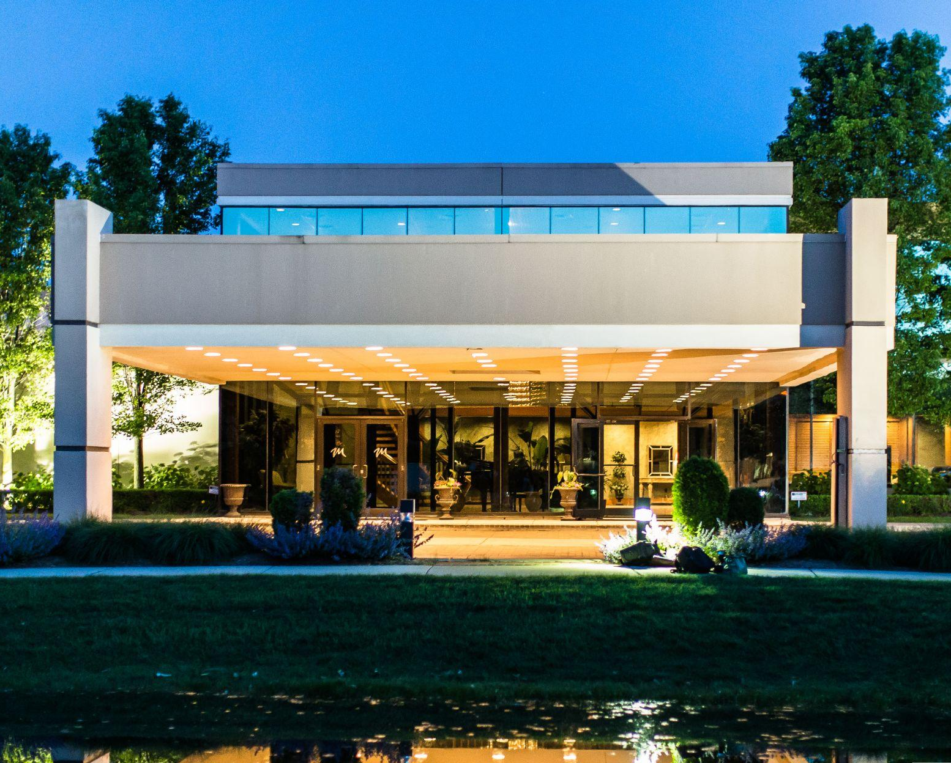
The Mirage Welcomes you to Explore our Endless Possibilities for your next Event

Slide 2
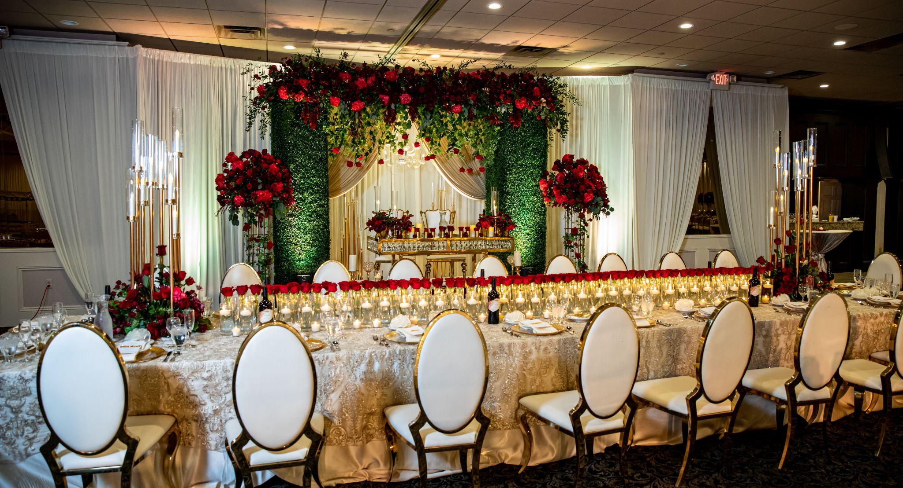
Welcome To
The Mirage
Nestled in the heart of Clinton Township, MI, The Mirage stands as a beacon of elegance and sophistication, offering a magical setting for the most memorable events. From fairy-tale weddings to grand corporate galas, our venue is designed to transform your dreams into reality.
At The Mirage, we believe every event should be as unique as those who celebrate it. Our stunning hall, accommodating up to 1,000+ guests, is a masterpiece of design, blending classic elegance with modern luxury. The flexible space is perfect for creating an intimate ambiance for smaller gatherings or an opulent setting for larger affairs.
The Mirage is more than a venue; it's a sanctuary where moments become memories. It's a place where laughter fills the air, where glasses clink in celebration, and where every detail contributes to an atmosphere of joy and festivity. Embark on a journey of unforgettable experiences at The Mirage. We invite you to celebrate life’s most cherished moments with us, surrounded by beauty, luxury, and an ambiance that is both enchanting and exhilarating.

Slide 3
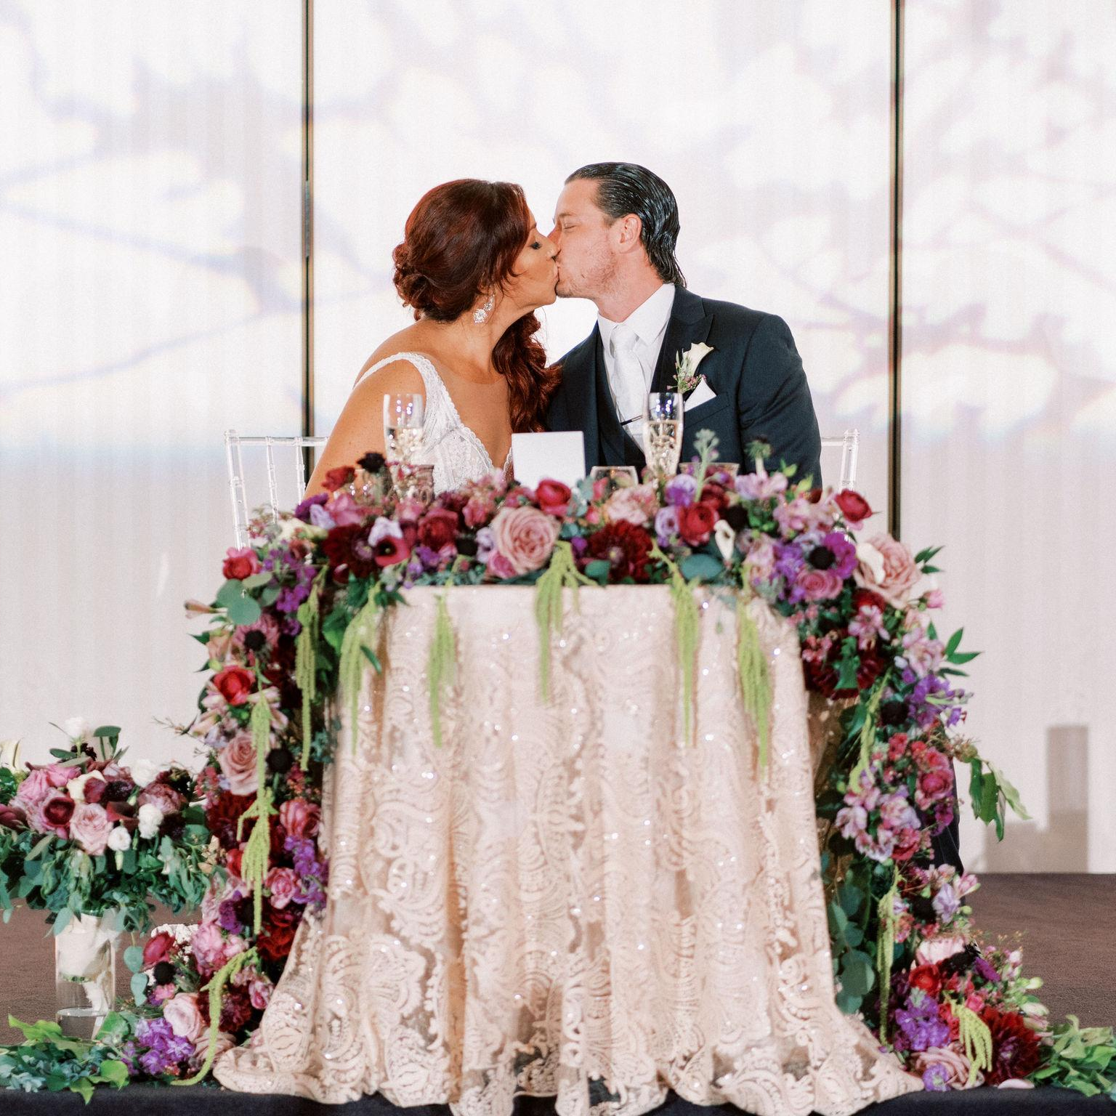
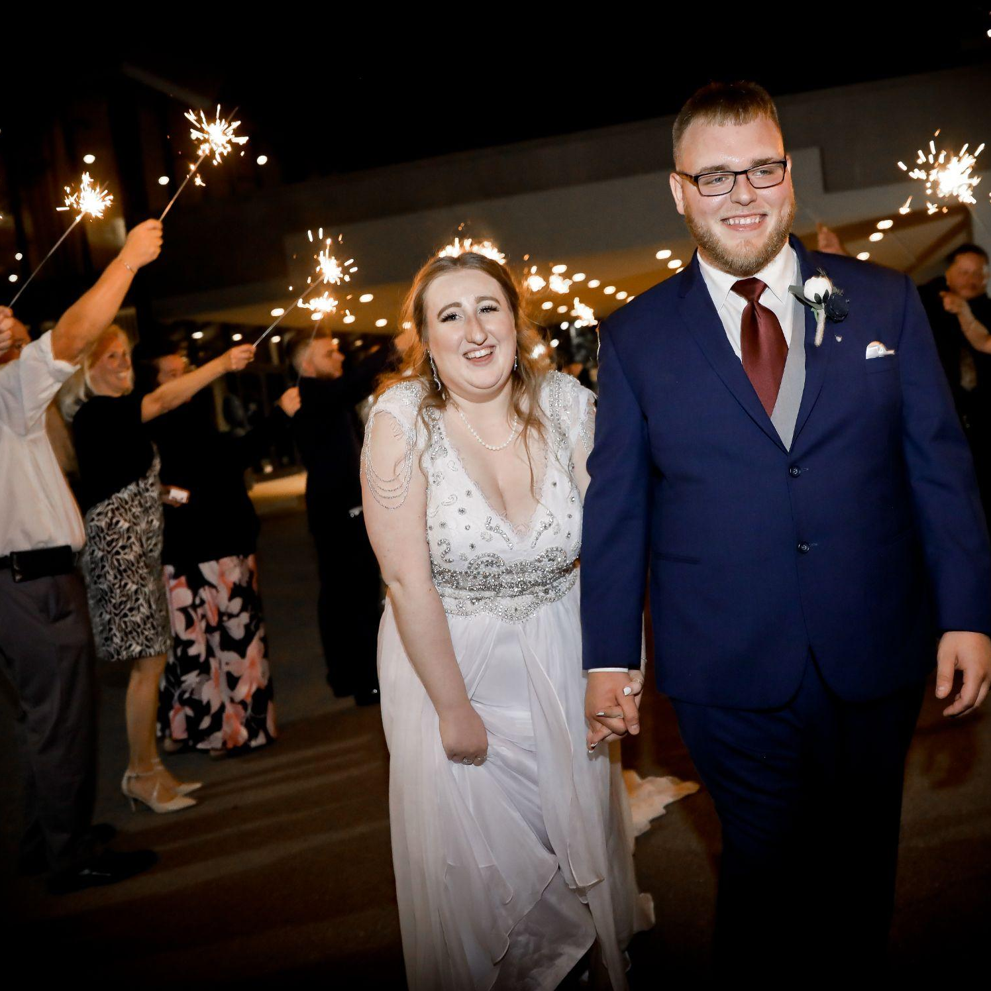
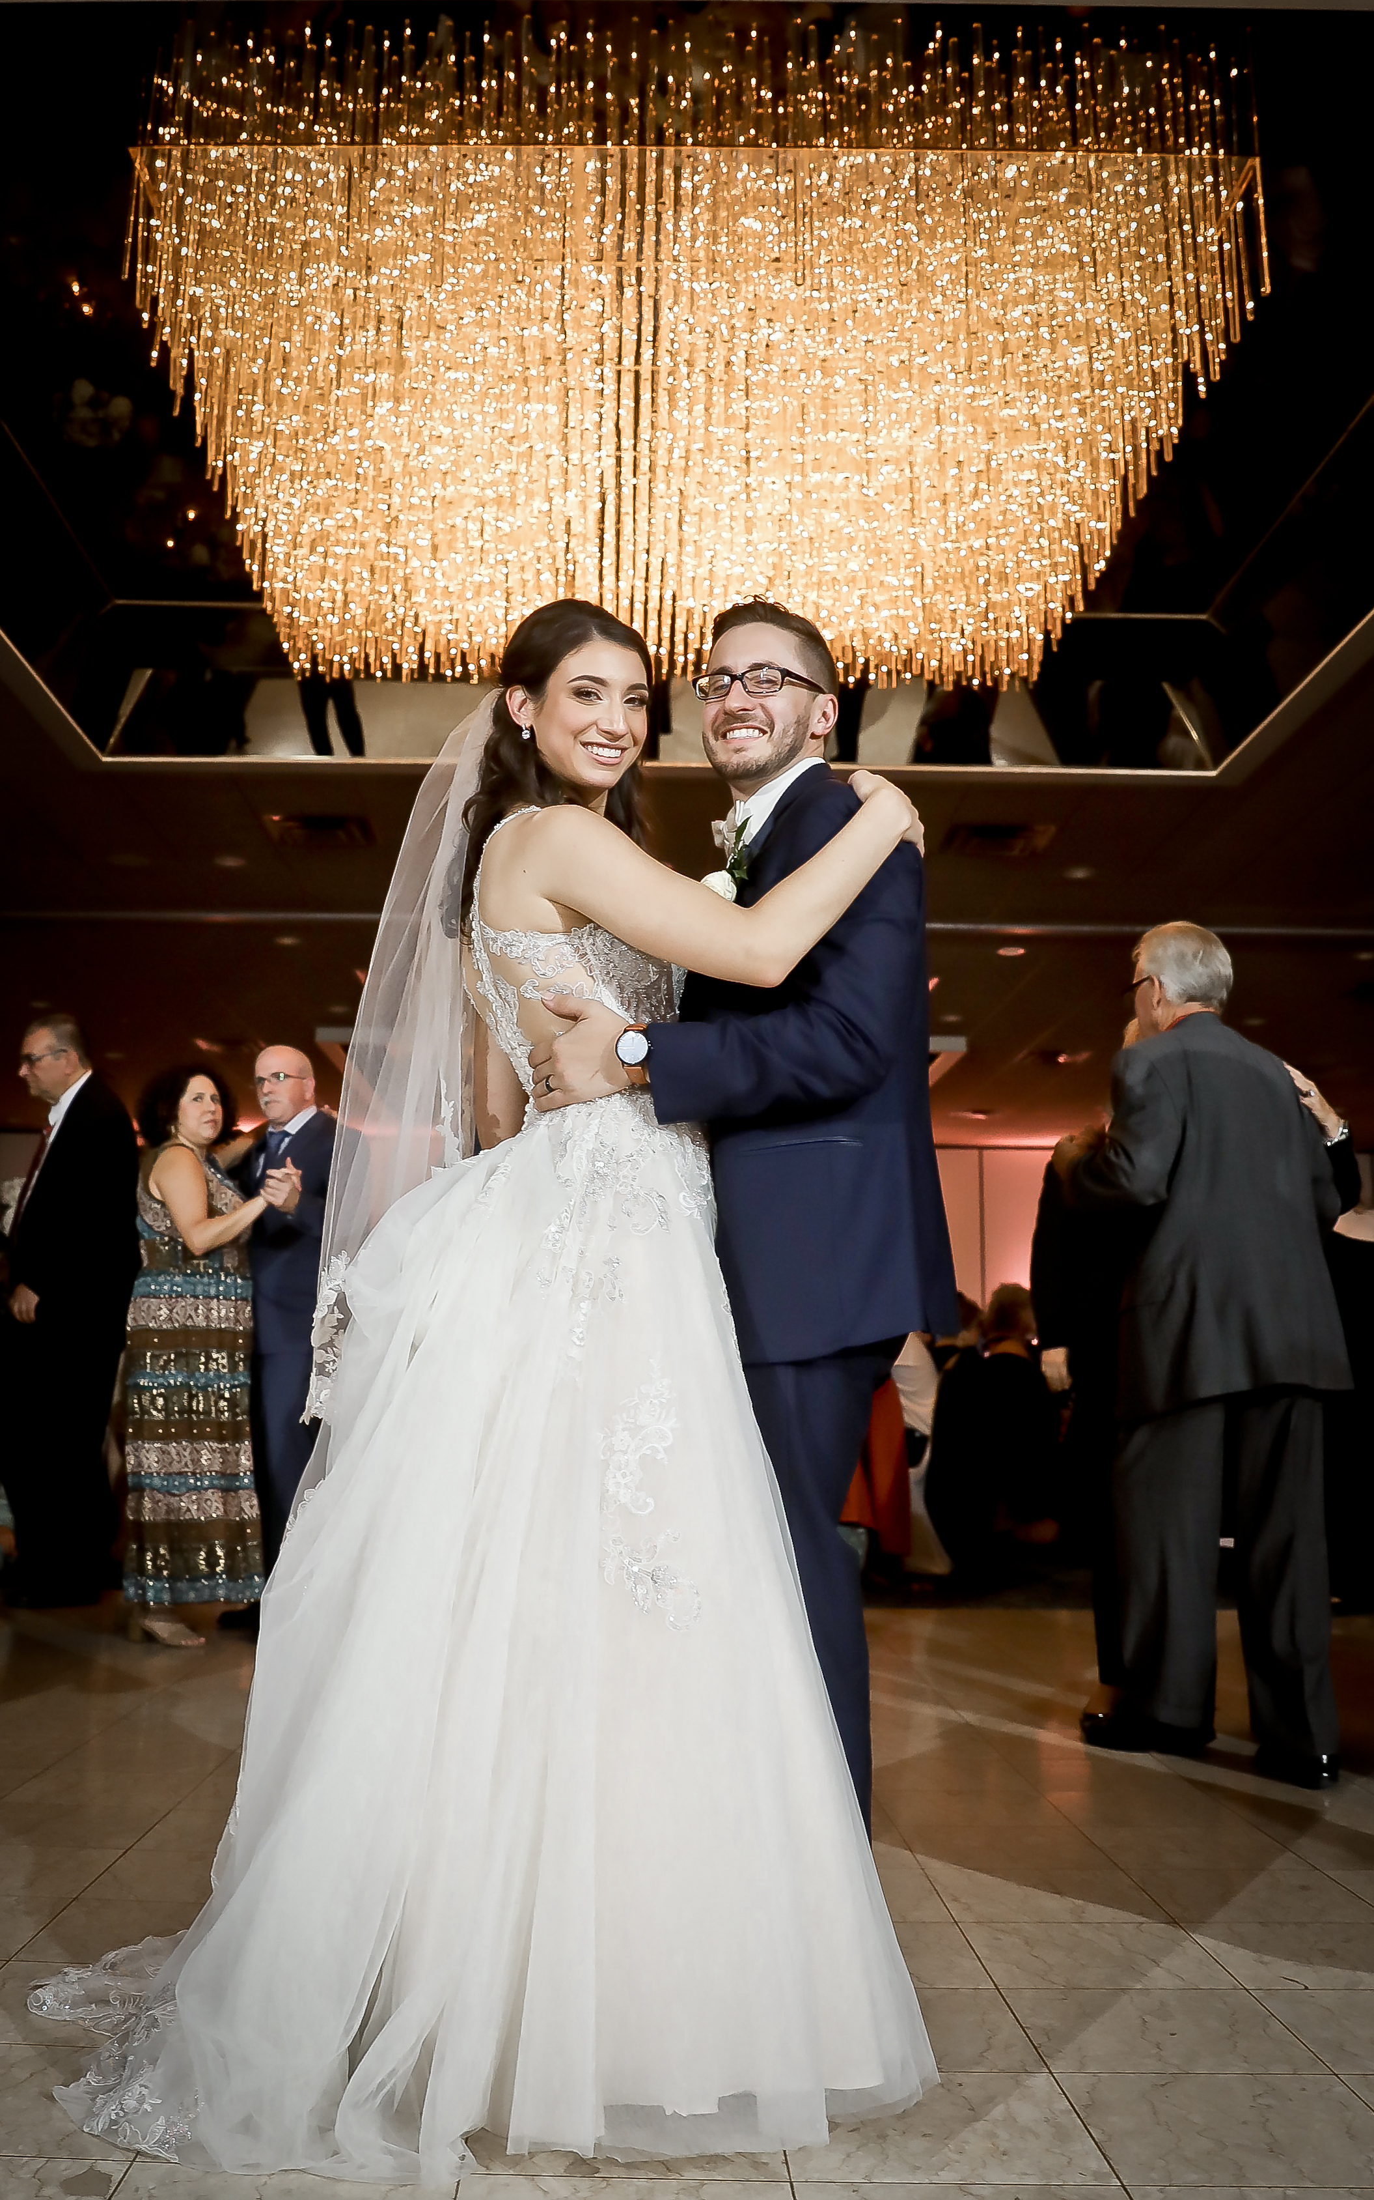
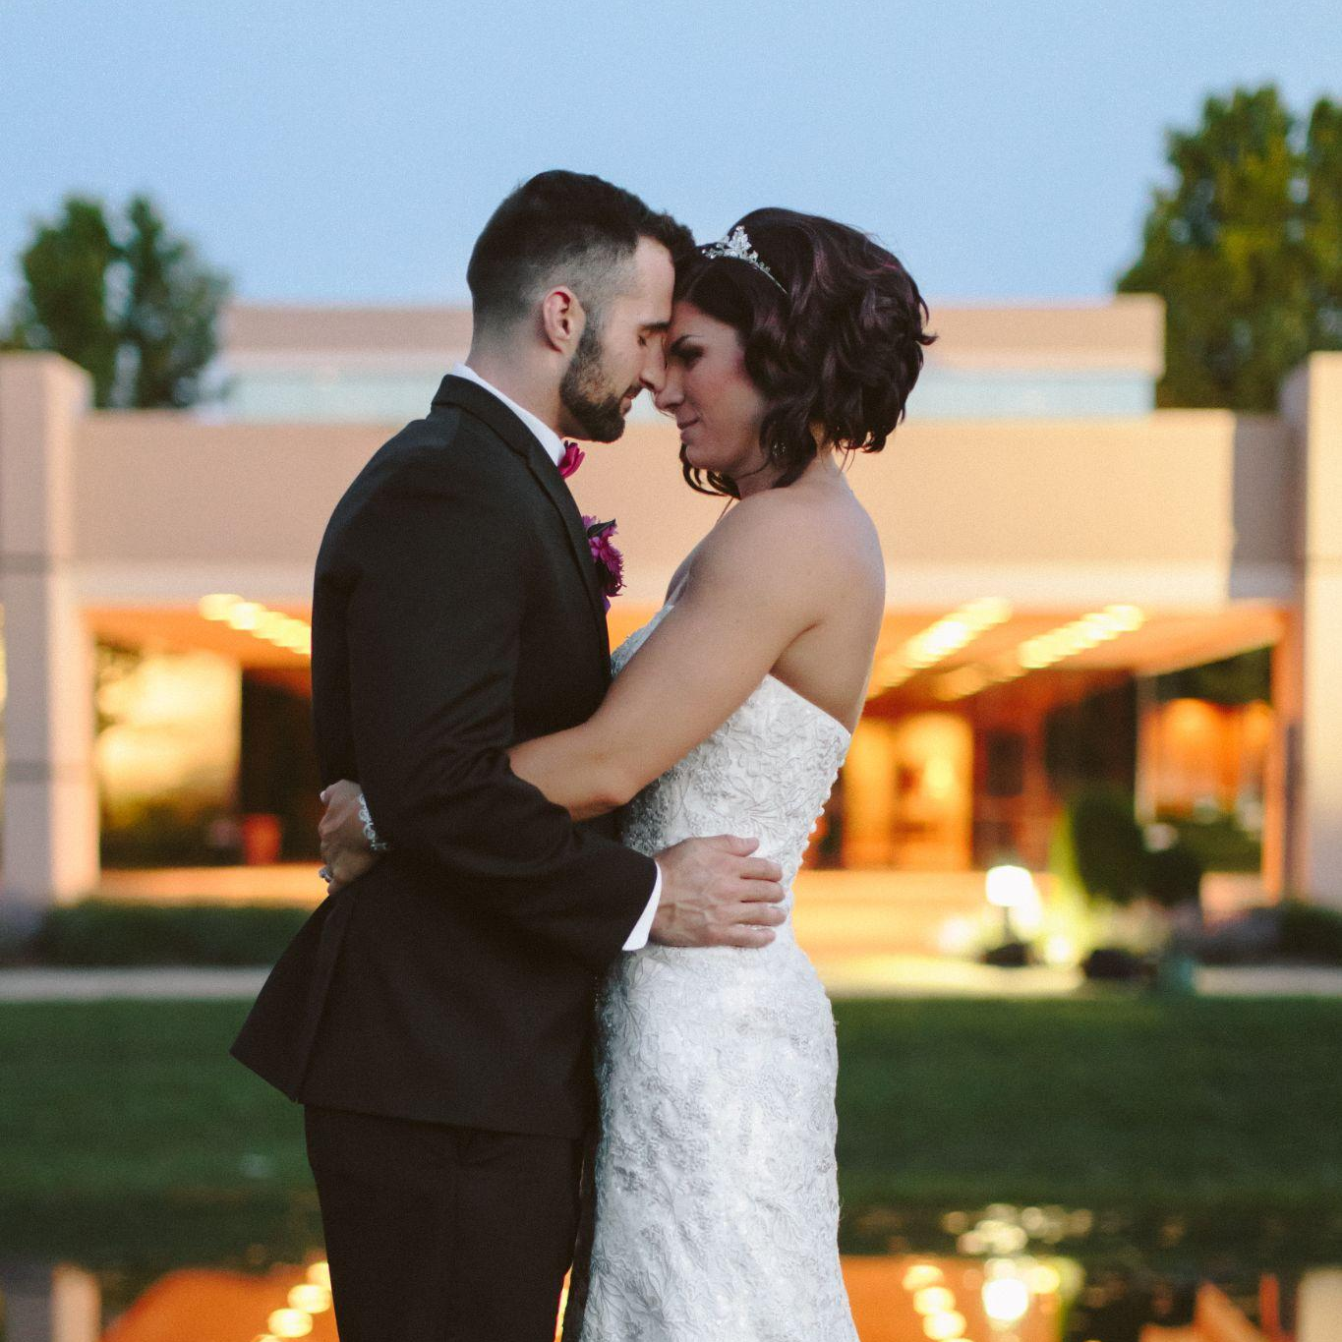
The Mirage
Pricing
Ultimate- $106 ($110 – Sat)
Experience the epitome of sophistication with our Ultimate package at The Mirage. This premier offering is complemented by the Ultimate Bar featuring a selection of top-shelf alcohol for the discerning palate. Guests will be welcomed with a celebratory champagne toast and can indulge in a lavish shrimp cocktail display, along with a delectable assortment of cheese, crackers, and crudité. Seating is elevated to a new level of elegance with your choice of stylish Chiavari chairs or classic chair covers complete with sashes. To complete the luxurious ambiance, specialty linens are provided, adding a touch of finesse to your event's décor. The real highlight of the evening comes with our Late Night Snack, featuring House Pizza and a Coney Island Station, perfect for satisfying those late-hour cravings. The Ultimate package is designed for those who seek a lavish and memorable event experience.
Supreme - $72 ($75 – Sat)
Elevate your event with The Mirage's Supreme package, a choice that combines luxury with customizable options. This package offers access to our stunning venue, complete with a Premium Bar that boasts a selection of fine spirits and drinks. The head table is greeted with a sophisticated champagne toast, the seating options are luxurious with sleek Chiavari chairs, complemented by elegant linens to enhance the overall decor. The Supreme package sets itself apart by offering the option to add on features such as the popular Late Night Snack feature, luxe linens, or center pieces, at a discounted rate. Tailored for those seeking flexibility without compromising on luxury, the Supreme package is the ideal choice for an unforgettable and customized event experience.
Essential - $56 ($60 – Sat)
Our Essential package at The Mirage is thoughtfully designed for those who desire the essentials of a beautiful wedding experience without the added frills. This package provides access to our elegant venue space, ensuring a charming and comfortable setting for your celebration. Included is a house bar, offering a selection of classic beverages to cater to your guests’ tastes. The Essential package is characterized by its desired and attentive service, ensuring all fundamental aspects of your event are handled with care and professionalism. This package is perfect for couples seeking a straightforward, no-nonsense approach to their special day, focusing on the joy and love of the occasion in a tastefully simple setting. The Essential package offers all the necessities to create a memorable and delightful wedding.

