Slide 1
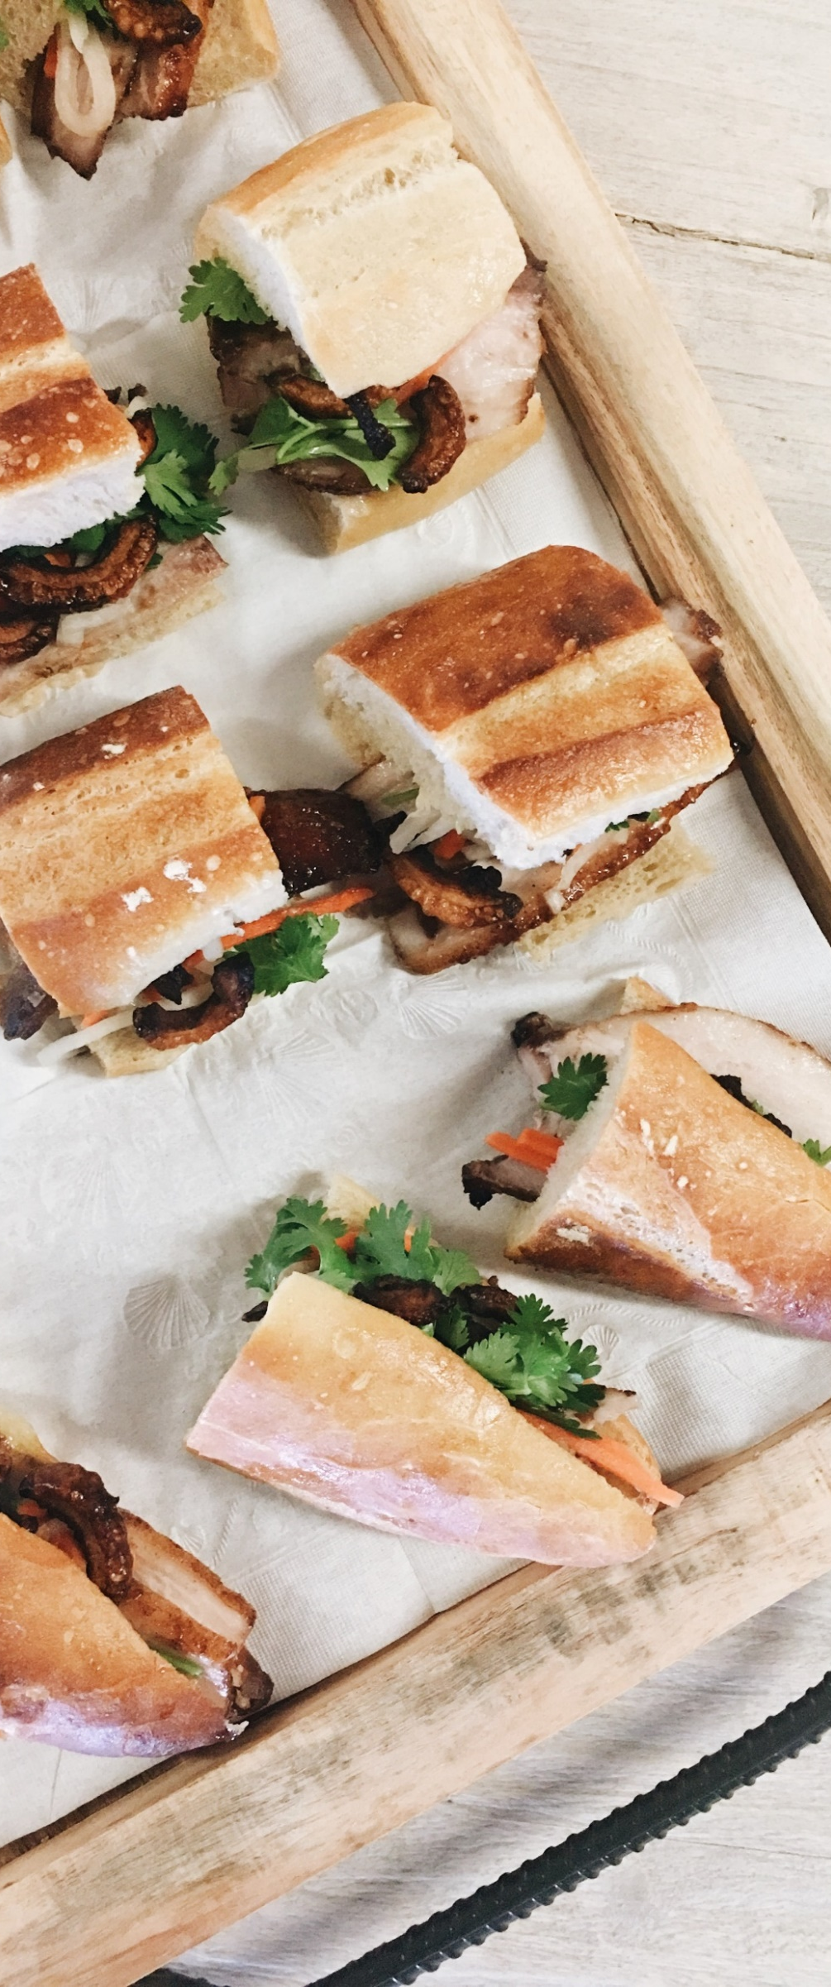
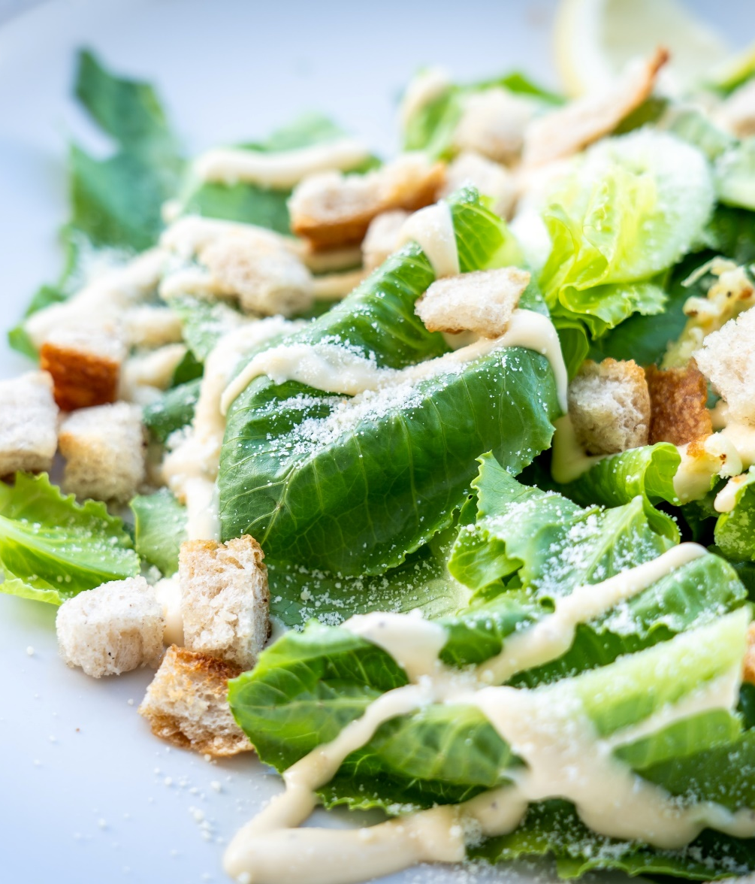
Baby Shower Packages
Serves 50 People.
Includes tables, chairs, linens, and the Audie Murphy Room Rental.
Package A
$750.00 | $22 per addition person
Charcuterie Boards
Seasonal Fresh Cut Fruit
Iced Tea
Water
Package B
$875.00 |$23 per additional person
Traditional Chicken Wings
- Sauces: Sweet Chili, BBQ, Buffalo, Hot Honey, Lemon Pepper
Vegetable Platter
Nachos & Cheese
Iced Tea
Water
Package C
$925.00 | $ 24 per additional person
Crispy Street Taquitos
Guacamole
Homemade Salsa
Sour Cream
Iced Tea
Water
Package D
$1,650.00 | $38 per additional person
Grilled Chicken Served with Crisp Romaine Lettuce
Caesar Dressing
Finger Sandwiches
Fruit & Cheese Platter
Marshmallow Dip
Iced Tea
Water
All items subject to 8.25% local food & beverage sales tax and 23% service charge

