Slide 1
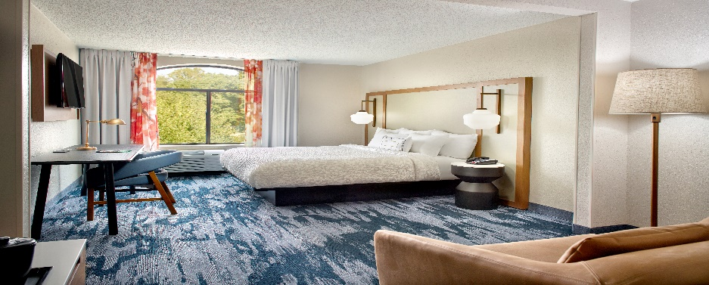
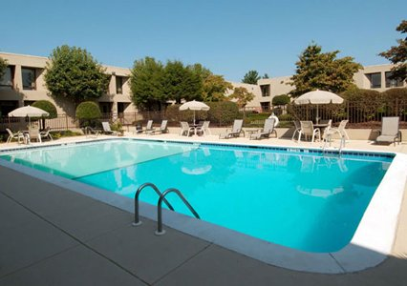
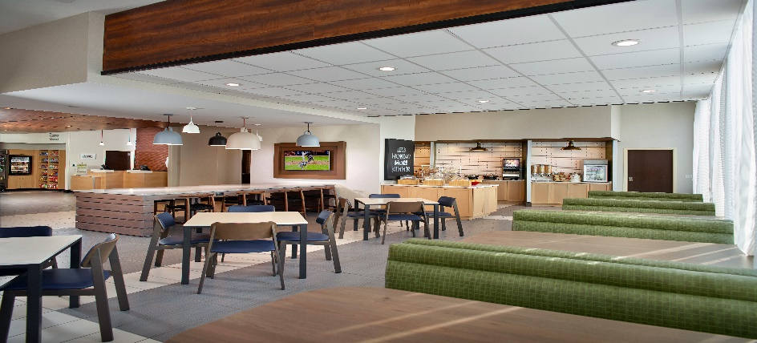
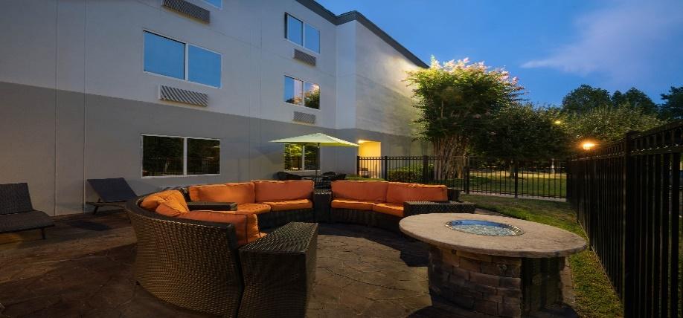
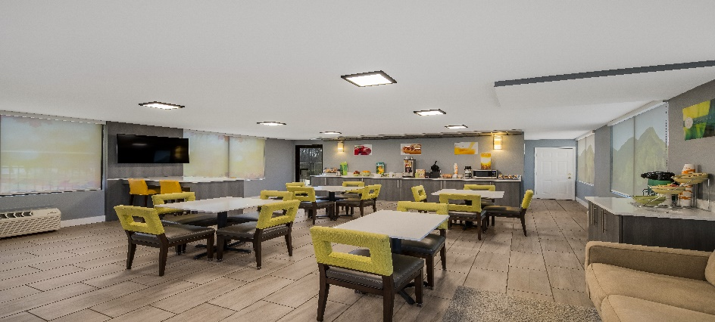

Asheville Area Hotels
www.bluestarhospitality.net
Fairfield Inn Asheville Biltmore
Phone: 1-828-665-4242
www.marriott.com/avlbs
Clarion Inn Asheville Airport
Phone: 1-828-684-1213
www.choicehotels.com/nc674
Fairfield Inn Asheville Airport
Phone: 1-828-684-1144
www.marriott.com/avlnc
Wingate by Wyndham Asheville Airport
Phone: 1-828-409-9385
www.wyndhamhotels.com
Quality Inn Asheville Airport
Phone: 1-828-684-1200
www.choicehotels.com/nc194
Known as an art colony, a healing resort and a home to notable luminaries, statesman and bohemians, Asheville is one of the most welcoming, vibrant cities in America
For groups, events and special discounts: Carmella.sharpton@bshllc.com
828-684-1213
Known as an art colony, a healing resort and a home to notable luminaries, statesmen and bohemians, Asheville is one of the most welcoming, vibrant cities in America.

Slide 2
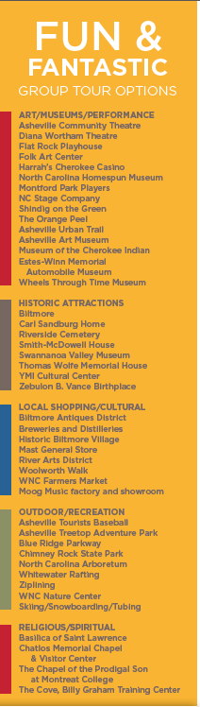
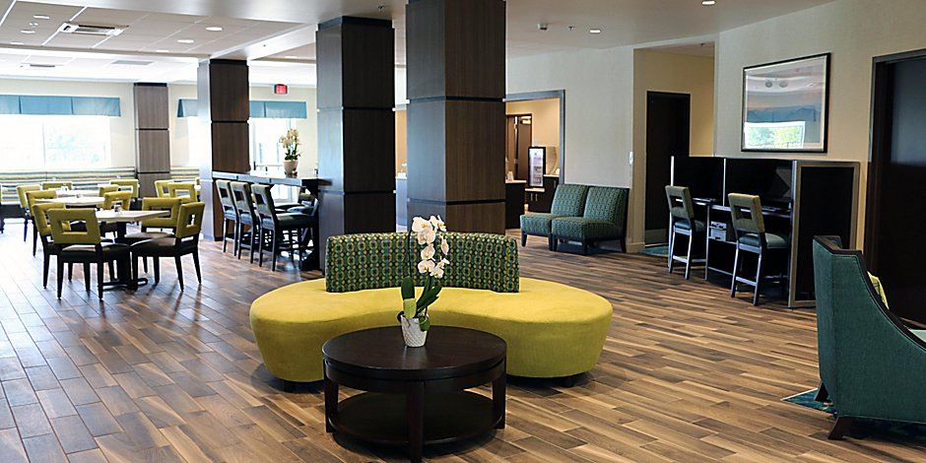
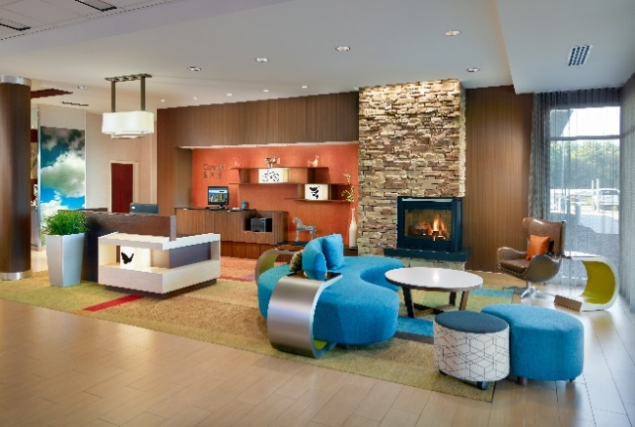
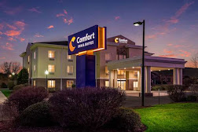
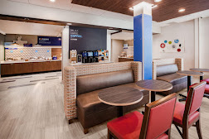
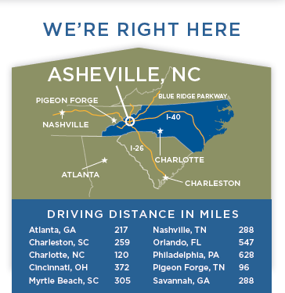
Holiday Inn Express Flat Rock
Phone: 1-828-698-8899
www.ihg.com/holidayinnexpress
Fairfield Inn Flat Rock
Phone: 1-828-513-5100
www.marriott.com/avlhv
Comfort Inn & Suites Brevard
Phone: 1-828-862-8900
www.choicehotels.com/nc898
Holiday Inn Express Brevard City Center
Phone: 1-828-348-8745
www.ihg.com/holidayinnexpress

